Slide 1
Boost
Your Sales
Alexandre d’Hose – « Failure is a diploma »

Slide 2
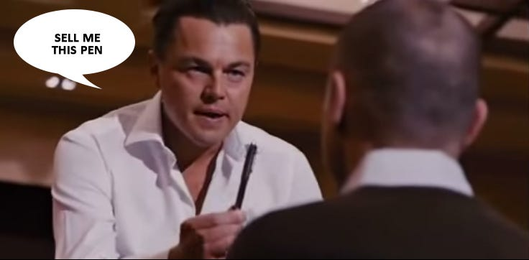

Slide 3
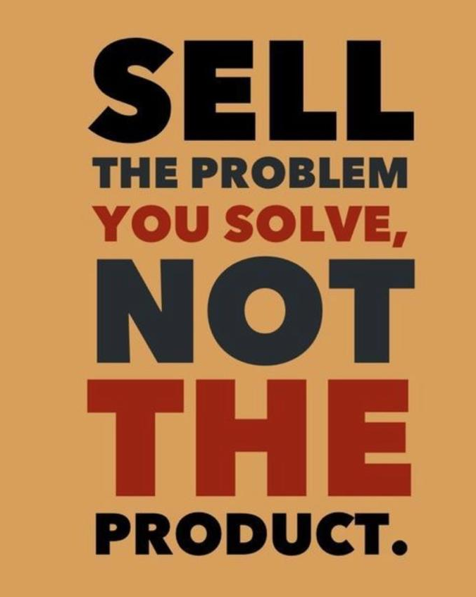
Alexandre d’Hose – « Failure is a diploma »

Slide 4
Comment standardiser son approche de vente - j'ai tendance à la rendre très personnelle mais du coup ça prend énormément de temps ?
Quels sont les meilleurs outils pour documenter et standardiser les démarches commerciales ?
Alors moi j'ai des questions sur l'aspect théorique de la vente. Genre s'il y a des études sur ce qu'il se passe dans la tête des clients, pourquoi ils achètent, pourquoi pas, et dans ce cas les techniques pour qu'ils achètent !

Slide 5
En agence de communication créative, on vient très souvent nous voir pour la gestion des réseaux sociaux en pensant qu'on fait principalement ça. Du coup, comment stimuler la vente des autres services d'une agence de communication créative ? Comment axer le discours pour que tous nos services (graphisme, création de site web, stratégie, création de contenu) soient retenus par le prospect ?
Pour ma part, je souhaiterais en apprendre davantage sur les stratégies de vente B2B.
Les outils les plus performants, comment créer une base de données pertinentes, où trouver ses prospects,…

Slide 6
Are you a ( Co )-Founder?
Vision, Market & Competition
How to communicate
Branding
KPI & Sales Strategy
Pricing
Mesure & Adapt

Slide 7
Are you a Co-Founder?
ONE of the Greatest
ASSETS
In sales is
Having
CONFIDENCE

Slide 8
Sales Pitch Strategy

Slide 9
HAVE THE POSITIVE MINDSET
FAITH AND CONFIDENCE
PRODUCT KNOWLEDGE
KNOW YOUR F------ PROSPECT

Slide 10
Different Sales Pitch
Sales Pitch
Cold Calling
Phone Prospection
Sales Pitch
Customer meeting
Webinar
Investor Pitch
Partnership

Slide 11
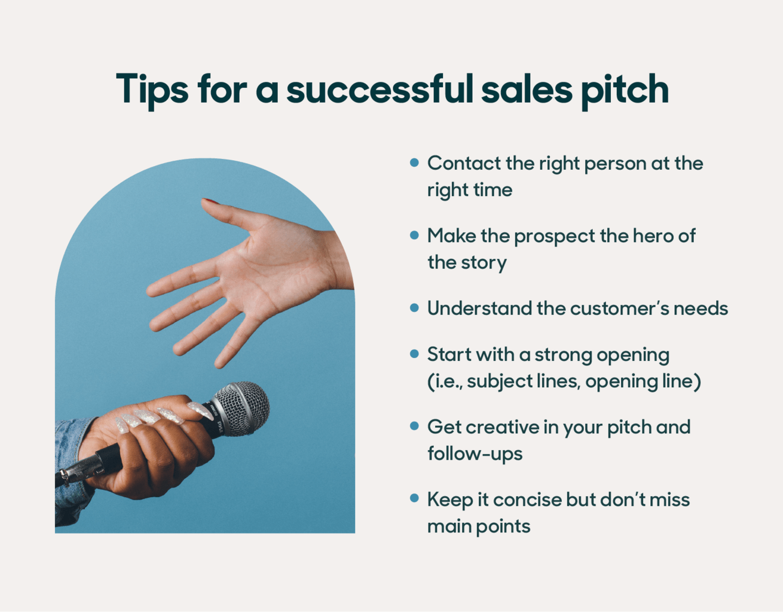
Sales Pitch Strategy

Slide 12
Sales Mentors
Simon Sinek
Golden Circle
Connor Neill
How to start a speech
Jordan Belford
Sell me this pen

Slide 13
Sales Mentors

Slide 14
The Secret to a Sales Pitch
SUCCESS
STOP worring about WHAT you’re saying
START Worring about HOW you’re saying it

Slide 15
The Secret to a Sales Pitch
SUCCESS
Selling an IDEA, an EMOTION, a BELIEVE
« Would you buy what you are selling? »
GET EXCITED ABOUT IT
Jordan Pitch Pitching to wife Eolis Group

Slide 16
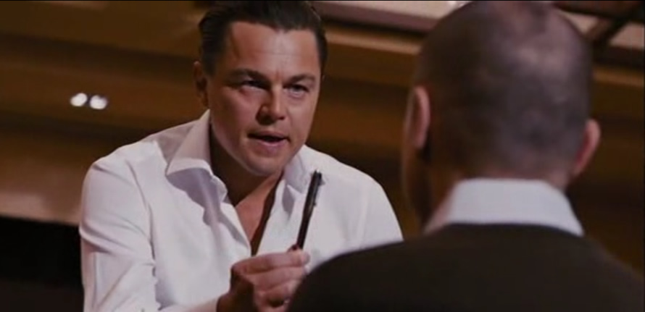
Sales Mentors
Sell me this pen
The truth well told
The best version of the truth

Slide 17
Example of brand positionig
Identity defines your
Brand
Brand define your Price
Price defines sales plan
As your
COMMUNICATION

Slide 18
Brand Strategy

Slide 19
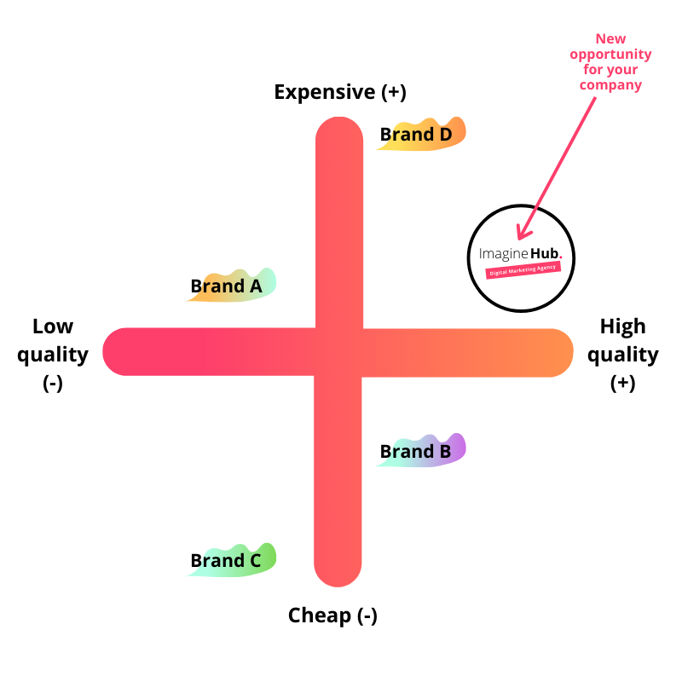
Price Strategy

Slide 20
Your digital Business companion
Your digital CAREER companion

Slide 21
Belgian Scale up
Founded in 2020
digital marketing in-housing agency
Transformation on Organizations
Building teams
Consulting

Slide 22
In-House Digital Marketing Partner
BUILDING TEAMS
BUILDING PROJECTS
CONSULTING

Slide 23
Our Sectors
Banking &
Insurance
Telecominication
Retail
Transport &
Logistics

Slide 24
SERVICES AND EXPERTISE
MARKETING & COMMUNICATION
Marcom Manager
Brand Manager
Digital Marketing
Campaign Manager
CRM Campaign Manager
Go to Market Manager
Growth Marketeer
Performance Marketeer
Copywriter
AI conversational Designer
COACHING & PROJECT MANAGEMENT
Agile Coach
Scrum Master
Project Manager
IT Project Manager
Digital Project Manager
Product Owner
Product Manager
Project Coordinator
Account Manager
DESIGN
Strategy Designer
Service Concept Designer
System Designer
User Experience UX Designer
User Interface UI designer
Architect Designer

Slide 25
OPTIMIZING YOUR DIGITAL ENVIRONEMENT
AI & COMMUNICATION
AI trainers
CHATGPT Agitators
BOT coaches
Prompt Engineers Manager
Conversational analysts
Bot Copywriter
AI conversational Designer

Slide 26
WHY EOLIS GROUP
EXPERTISE
COMPETITIVITY
FLEXIBILTY

Slide 27
Digital Transformation Isn’t a Sprint, It’s a Marathon.

Slide 28
Your digital CAREER companion

Slide 29
The Business goals
CUSTOMER
PREPARATION IS KEY

Slide 30
The Secret to a Sales Pitch
SUCCESS
It’s not a Pitch
It’s a Conversation

Slide 31
Psychology of the client
What’s in it for him?
What do you want him to remember
What can you do better than anybody else?
Whats your competitive advantage?
Who is your Target?

Slide 32
Help your prospect
Understand
What your product :
IS
DOES
MEANS

Slide 33
The Secret to a Sales Pitch
SUCCESS
BEST PRACTICES / MINDSET
People buy emotion
Tell prospects your price, then, shut the fuck up
It’s easier to sell an offer that solves a pain than one fulfilling a desire.
Whatever business you’re in, study psychology, cognitive bias, and body language.
Your service / Product should meet demand, not try to create it.
People don’t care about your offer, only what your offer can do for them

Slide 34
The Secret to a Sales Pitch
SUCCESS
BEST PRACTICES / MINDSET
The market isn’t “saturated”, your offer just sucks
You can be terrible at sales calls even if you have a great offer
There’s no such thing as too high of price, only too little value.
Specific words and numbers are more believable than broad ones.
A happy customer is the most powerful form of marketing

Slide 35
The Secret to a Sales Pitch
SUCCESS
BEST PRACTICES / MINDSET
Sales is about listening
Marketing & sales is about empathy
Use the words “you” and “your” in your pitch to make it more engaging.
Use headlines to steal attention and hooks to keep it.
An average product with great marketing will outsell a great product with bad marketing.

Slide 36
The Secret to a Sales Pitch
SUCCESS
BEST PRACTICES / MINDSET
Charge “high” prices so you can deliver more value for your clients.
Handle objections in your FAQ to increase conversion.
Your sales pitch shouldn’t be over 2 minutes.
Never sacrifice your reputation for money.
To grow at the start, say yes to many opportunities, but to continue growing, learn to say no.
Use Power thesaurus to replace boring words with strong ones to increase conversions.

Slide 37
The Secret to a Sales Pitch
SUCCESS
BEST PRACTICES / MINDSET
It’s okay to fire clients that are a pain in the ass.
If you don’t think you can help a prospect, be honest.
There will always be a market for health, wealth and relationships.
Compete on value, not price
A child should be able to understand what you sell.
If what you sell is confusing, nobody will buy.

Slide 38
Why don’t we close enough deals?
BECAUSE WE DON’T ASK
Because we don’t ask closing questions
What is holding you?
Why don’t we start working right now?

Slide 39
Q&A

